Slide 1
Year 4 Statutory Assessment Information

Slide 2
Multiplication Tables Check
In Summer Term 2, all of Year 4 complete an online times table check.
This assessment is designed to check children’s understanding of times tables facts up to 12 x 12.
In Maths and mastering number we will be looking at times tables as is set out in the national curriculum.
Outside of these lessons we will also be doing two sessions of Times Tables Rock Stars (TTRS) but encourage children to be practicing at home as well. Jamming mode is a great and fun way to practice these, but we also push for children to use the Soundcheck feature as this simulates the timing of the Multiplication Check.

Slide 3
Home Learning
Our home learning will be focused mainly on times tables practice to support in children’s understanding ready for the check.
Please make sure your children are completing these each week as well as going on TTRS.
Home learning will be sent out on a Thursday and is expected to be returned and collected by the following Tuesday. If there are any issues with completing this in time just let me know. We will be looking at this all together so that we can check understanding and see any problem areas across the class.
I am looking for effort as well as improvement with these and would love to celebrate any achievement so it would be lovely to see the children getting involved in both the home learning and TTRS!

Slide 4
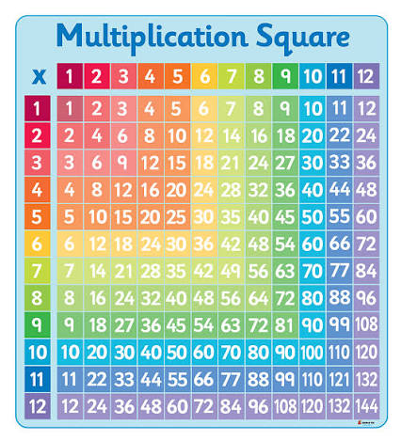
Top Tip:
Print off a multiplication square so that you can read, cover, write, check.

